Slide 1
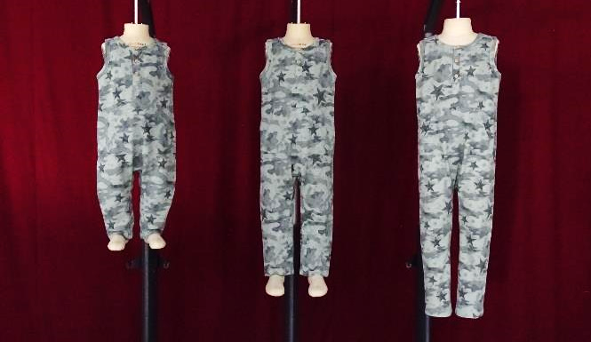
PID#1048XK , Vendor Grading & Technical Approval, Approved, 1 of 4
18M 3T 5T
Full DFA digital
Full DFA comment:
Fit and Balance are good.
Accredited Full BPFE comment:
N/A

Slide 2
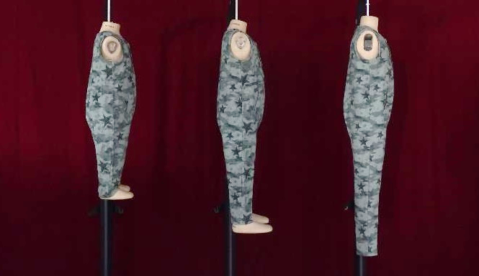
PID#1048XK, Vendor Grading & Technical Approval, Approved, 2 of 4
18M 3T 5T
Full DFA digital
Full DFA comment:
Fit and Balance are good.
Accredited Full BPFE comment:
N/A

Slide 3
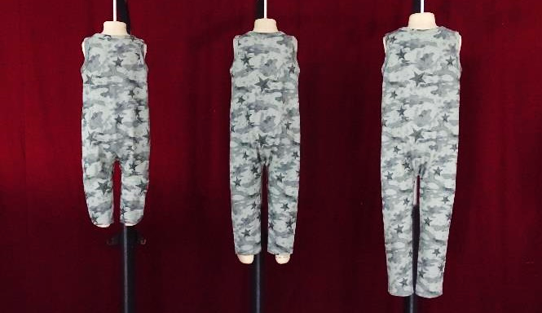
PID#1048XK , Vendor Grading & Technical Approval, Approved, 3 of 4
18M 3T 5T
Full DFA digital
Full DFA comment:
Fit and Balance are good.
Accredited Full BPFE comment:
N/A

Slide 4
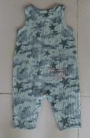
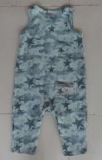

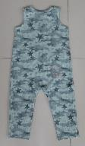
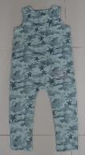
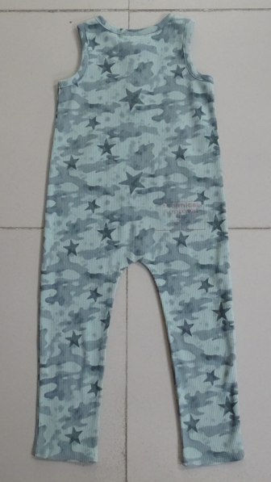
PID#1048XK , Vendor Grading & Technical Approval, Approved, 4 of 4
12M
18M
2T
3T
4T
5T
Full DFA digital

